Slide 1

Tuberculosis
Julie Kennedy, PGY-1

Slide 2
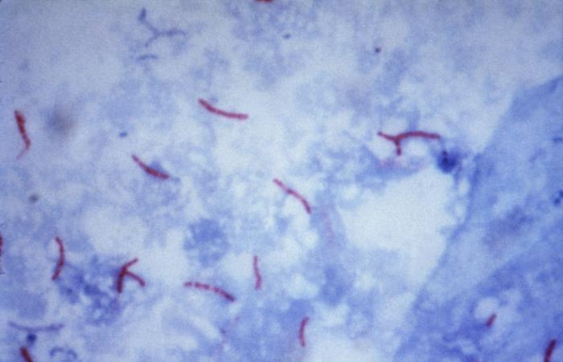
Mycobacterium Tuberculosis
Aerobic rods w/ mycolic acid cell wall (long, branched lipid attached to arabino galactan)
Culture is gold standard: takes 3-8 weeks to grow
Ziehl-Neelson stain: 60% sensitivity compared to Cx
  Sensitivity increases by approx 10% w/ second & 2% w/ third sputum sample
  Cannot differentiate between mycobacteria
http://pathmicro.med.sc.edu/infectious%20disease/mycobacterial%20diseases.htm

Slide 3
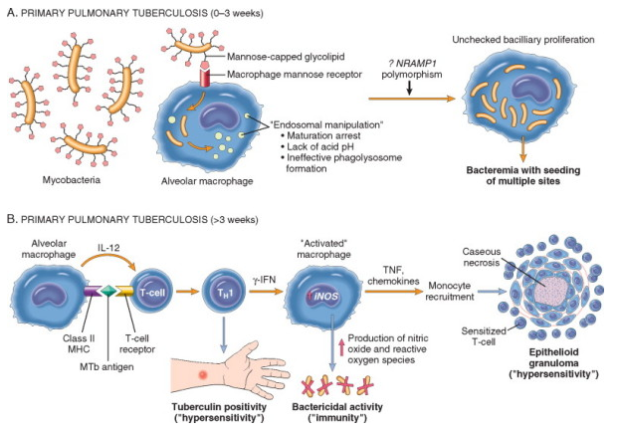
Mycobacterium Tuberculosis
Infects macrophages & proliferates w/in pulmonary alveolar macrophages & airspaces
Th1 response activates macrophages to form granulomas
IFN-g & TNF involved in signaling pathways
  Tx for RA w/ TNF antagonists confers increased risk of reactivation
Kumar et al. 2010. Robbins & Cotran Pathologic Basis of Disease, 8th ed. Elsevier, New York.

Slide 4
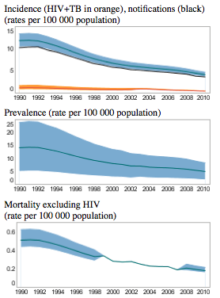
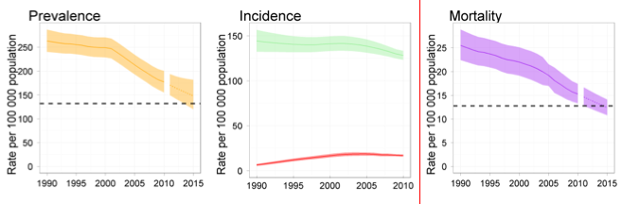



Epidemiology
Affects 1.7 billion people worldwide
8.8 million new cases worldwide in 2010
  11,182 in the US (60% are in immigrants)
    Declining since 1992
    Asian > Pacific Islanders > Blacks > Hispanics > Natives > Whites
1.4 million deaths last year (95% in developing world)
  547 deaths in US in 2009
United States
(WHO)
Worldwide
HIV positive (red)
Target 50% reduction (dashed)
Mortality excludes deaths among HIV pt’s
(WHO)

Slide 5
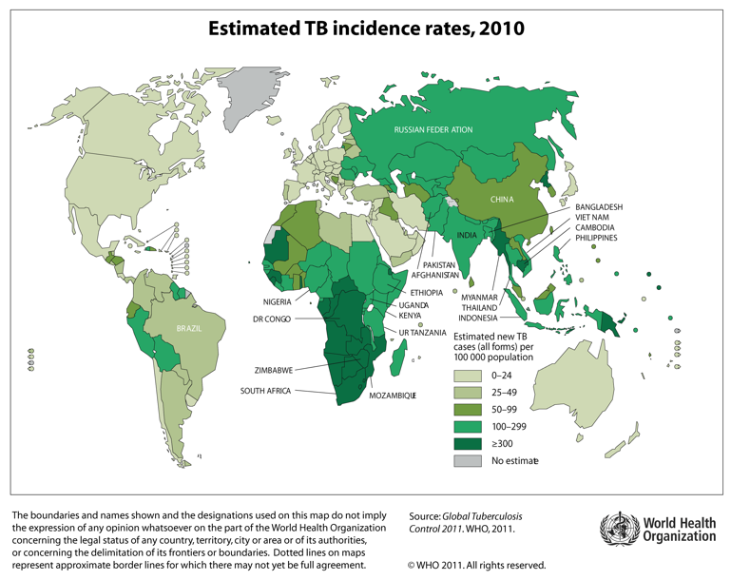

Slide 6
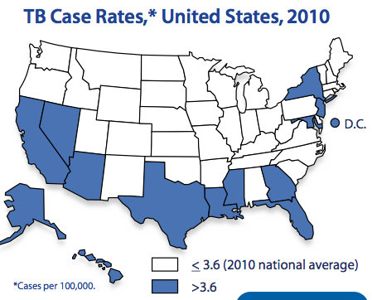
Epidemiology

Slide 7
Bacille Calmette Guerin
Live attenuated vaccine
Duration of immunity quite variable, usually 10-15 yrs
  No evidence supporting re-vaccination
Efficacy in preventing active TB approx 50%
  PPD NOT used to indicate efficacy/immunity
Not recommended in countries w/ yearly:
  Pulmonary TB rate < 5/100,000
  Meningitis rate in children < 1/10 million
  Risk of TB infection < 0.1%
Consider vaccinating:
  PPD negative pt’s exposed to multidrug resistant TB
  Healthcare workers from low-risk countries working in endemic areas
  For information on policies in different countries, visit: http://www.bcgatlas.org/

Slide 8
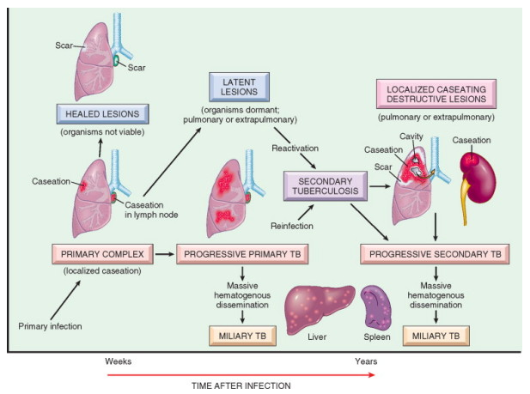
Active TB
Primary TB
Reactivation TB either by activation of quiescent bacteria or reinfection with new strain
Miliary TB via hematogenous spread either during primary or reactivation
Contagious only during active pulmonary TB
Must have microbiological dx for active infection
Kumar et al. 2010. Robbins & Cotran Pathologic Basis of Disease, 8th ed. Elsevier, New York.

Slide 9
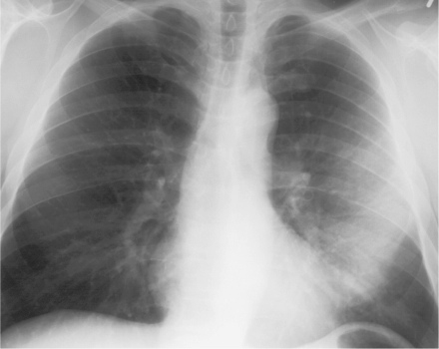
Primary TB
Often asymptomatic
  Fever > chest pain or pleurisy > retrosternal or interscapular dull pain > fatigue, cough, arthralgias, pharyngitis
Findings: hilar adenopathy > pleural effusions > infiltrates
Favors R middle or lower lobes
Ghon complex: focus + lymph nodes
  Heals by fibrosis
Adam. 2008. Grainger & Allison's Diagnostic Radiology, 5th ed. Elsevier

Slide 10
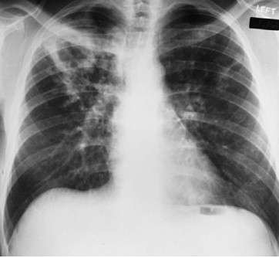
Reactivation TB
Insidious onset
Sx’s: cough, weight loss, fatiuge > fever, night sweats > chest pain, dyspnea > hemoptysis
Findings: upper lobe infiltrates > cavities > hilar adenopathy, middle-lower infiltrates, pleural effusions, solitary nodules
Favors posterior apical segments
  May form cavitary lesions (hypersensitivity)
Mason. 2010. Murray and Nadel's Textbook of Respiratory Medicine, 5th ed. Elsevier

Slide 11
Complications
Endobronchial spread from adjacent parenchymal focus or spread from distant site via infected sputum
  Can lead to ulceration or perforation, obstruction, atelectasis, bronchiectasis, stenosis
Hemoptysis: active > after tx, usually small volume
  Rasmussen’s aneurysm: TB extends into arteries causing massive hemoptysis
Pneumothorax: < 1% of hospitalized pt’s
Bronchiectasis: extrinsic compression by lymph node, fibrosis → bronchial dilation, stenosis
Extensive pulmonary destruction: 2/2 yrs of chronic reactivation TB
  Pulmonary gangrene: 2/2 acute destructive process

Slide 12
Latent TB
Testing indicated only if pt at increased risk & would benefit from treatment
  Increased risk of new TB inf: close contact w/ pt w/ active pulm TB; casual contacts of highly contagious pt’s w/ active TB; health care workers & other professions w/ high risk of exposure
    Re-test 8-12 weeks after initial negative test
  High risk of reactivation: HIV; transplant chemoTX, other major immunocompromise; abnormal CXR w/ apical fibronodular changes; silicosis; dialysis
    Tx recommended for all pt’s
  Moderate risk: DM; steroid use
    Tx NOT recommended for pt’s > 65 yo 2/2 risk of INH hepatitis
  Slightly increased risk: underweight; smokers; CXR w/ solitary granuloma
    Tx NOT recommended for pt’s > 50 yo

Slide 13
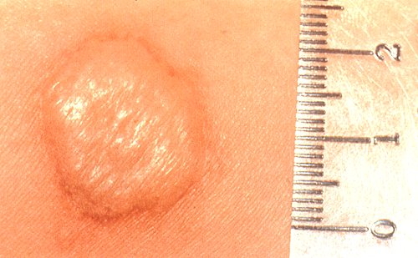
Tuberculin skin test (PPD)
Used to identify individuals with previous sensitization—NOT for dx of active TB or to monitor response to tx
Type IV, delayed hypersensitivity reaction w/ T-cell mediated causing induration 48-72 hrs after intradermal injection
Sensitivity: 80%
Specificity: 97% in non- & approx 60% BCG vaccinated pt’s
http://www.graphicshunt.com/health/images/tuberculosis_skin_test-1924.htm

Slide 14
Tuberculin skin test (PPD)
If documented positive, should never be repeated
  False positive: Non-TB mycobacteria, BCG vaccination
  Threshold:
    > 5 mm INDURATION for HIV; close contact; CXR w/ fibrotic changes; immunosuppressed
    > 10 mm for silicosis, dialysis, diabetes, malignancy, underweight, JI bypass, IVDU; < 4 yo; born in endemic country; residents & employees of correctional & healthcare facilities, mycobacterial labs, homeless shelters
    > 15 mm for healthy persons w/ low liklihood of true TB inf
  Eval of sx’s, CXR, PEx
    CXR negative: repeat CXR in the future for suspicious sx’s
    CXR w/ stable upper lobe fibronodular disease or calcified granulomas: latent tx, consider HIV testing
    CXR w/ parenchymal abnormalities, esp upper lobe: sputum Cx’s & tx as appropriate

Slide 15
Tuberculin skin test (PPD)
If negative, should not be repeated unless: close contact w/ active pulm TB pt; ongoing exposure; to est baseline prior to serial testing
  False negative: immunosuppresion; improper tuberculin handling or interpretation; other infection or recent live virus vaccination; age
  For severely immunocompromised pt’s w/ recent close contact, consider latent tx
“Booster” response: initial negative test becomes positive when repeated after 1-4 wks (in absence of exposure) 2/2 immune restimulation
Conversion: > 10 mm or increase > 6 mm from previous testing

Slide 16
IFN-g release assay
NOT for dx of active disease or to monitor response to tx
Measures T-cell release of IFN-g in response to TB-specific antigens
Can distinguish between BCG vaccination & TB infection
Affected by M marinum & M kanasii but not affected by many other non-TB mycobacterial infections
Sensitivity: TSPOT 90%, QFT 80%
Specificity > 95%
May see booster response 2/2 recent PPD (few days-3 mos)
NOT superior to PPD in identifying new TB infection
Pros: does not require f/u, not dependent on reader interpretation
Cons: expensive, less data (including cut-offs of serial testing)

Slide 17
IFN-g release assay
US guidelines:
  Can be used in place of, but not in addition to, PPD
  Preferred for pt’s who have received BCG or who are unlikely to f/u for PPD reading
  PPD preferred for children < 5 yo
  Both tests might be useful for:
    Pt’s high risk pt’s w/ negative initial test
    Pt’s w/ positive initial test & who need to be encouraged to adhere to tx or who have very-low risk of actual infection
  Re-testing might be indicated if indeterminate results & persistent reason for testing

Slide 18
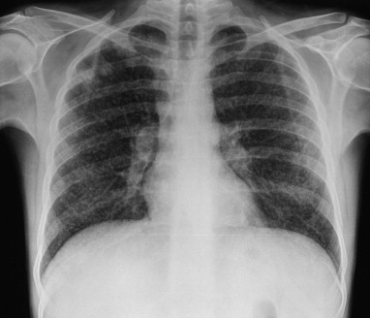
Miliary TB
During primary infection: acute, fulminant
Reactivation: subacute/chronic
Common sites: skeletal, CNS, GI/peritoneum, renal, lymph nodes
Less common: cardiovascular (pericarditis), adrenal, skin (cutis miliaris disseminata)
Albert. 2008. Clinical Respiratory Medicine, 3rd ed. Elsevier.

Slide 19
Extrapulomonary TB
Skeletal TB: 10-35% of extrapulmonary TB
  Vertebral (Pott’s disease): ½ of skeletal TB
    L & lower-T spine most often
    Abscesses may impinge on surrounding structures
  Arthritis: usually monoarticular in weight-bearing joints (hip most common)
    Synovial fluid analysis usually unrevealing
  Osetomyelitis: “cold abscess” in almost any bone
  Non-specific radiographic findings (soft tissue swelling, osteopenia, bone destruction)
  Biopsy & Cx is preferred method of dx
Lymph nodes:
  Cervical lymphadenitis (scrofula) most common
  Dx: histopathology & AFB smear obtained by bx
Renal: dysuria, gross hematuria
  UA usually sterile but AFB staining will reveal MTB

Slide 20
Extrapulmonary TB
Central nervous system: 6% of extrapulmonary infections
  Meningitis definitive dx w/ CSF acid fast stain & Cx
  Tuberculoma: conglomerate of caseous foci
    May see enhancing lesions on radiography
  Spinal tuberculous arachnoiditis: subacute onset with nerve root & cord compression signs
Gastroentestinal:
  Nonspecific abdominal/GI sx’s, elevated LFTs, pancreatitis, cholecystitis
  Enteritis: often involves ileocecal region
    Definitive dx w/ endoscopic bx
  Peritoneal TB: ascites w/ SAAG < 1.1
    Gold standard for dx: positive ascitic Cx or periotneal bx

Slide 21
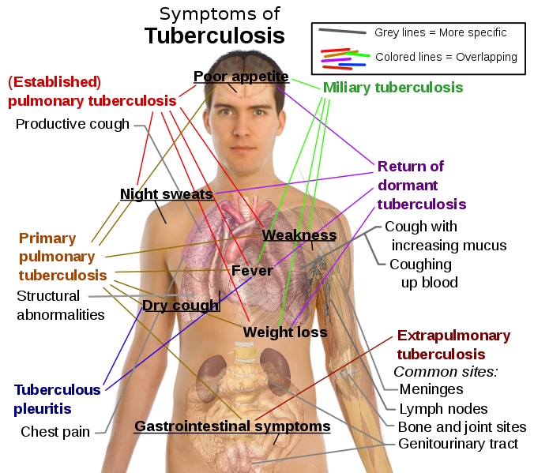
Extrapulmonary TB
Wikipedia: 676px-Tuberculosis_symptoms.svg

Slide 22
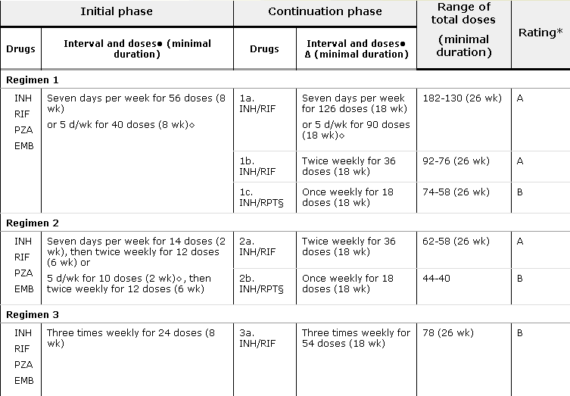
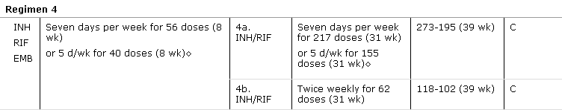
Treatment of active TB
Initial phase: 2 months w/ 4 agents
  If sensitive to INH, RIF, & PZA, can d/c EMB
  May exclude PZA from tx if severe hepatotoxicity
Continuation phase: 4 months w/ INH & RIF
  Extend to 7 months if: cavitation & positive sputum at end of initial phase or if initial phase did not include PZA
  Or weekly Rifapentine + INH x 2 mos
    For pt’s w/ no cavitation
Am J Respir Crit Care Med 2003; 167:603

Slide 23
Alternate regimens
Isoniazid intolerance:
  6 months RIF + PZA + EMB
  12 months RIF + EMB w/ PZA during initial 2 months
Rifampin intolerance: 18 months INH + EMB +/- FQ
  Consider PZA during > initial 2 months
  Also consider injectable agent during first 2-3 months to shorten total tx duration to 12 months
Pyrazinamide intolerance: 9 months INH + RIF w/ EMB until susceptibility resulted
Severe unstable liver disease: 18-24 months Streptomycin + EMB + FQ + another second-line agent
  Optimal choice of agents & duration of tx uncertain

Slide 24
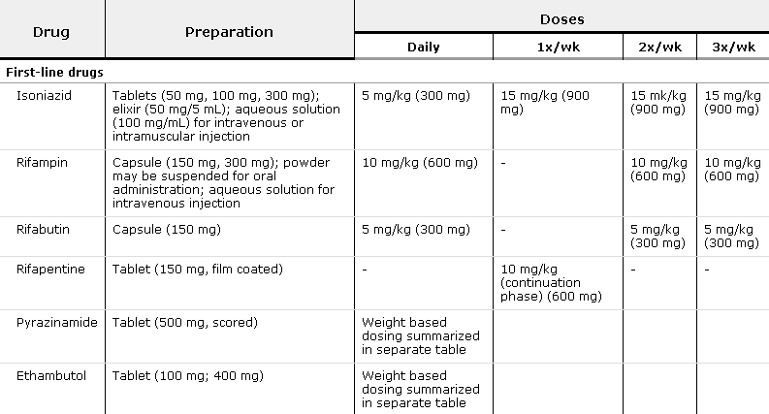
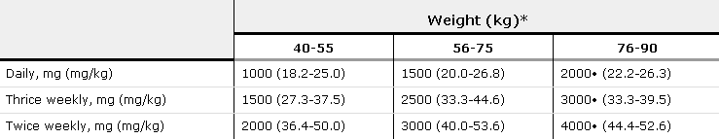
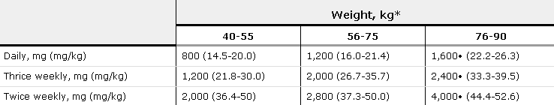
Dosing
Blumberg, HM, Burman, WJ, Chaisson, RE, et al. American Thoracic Society/Centers for Disease Control and Prevention/Infectious Diseases Society of America: treatment of tuberculosis. Am J Respir Crit Care Med 2003; 167:603.
PZA
Renal dosing | Three times per week
PZA | 25-35 mg/kg (max 2.5 g/dose)
EMB | 15-25 mg/kg (max 1.6 g/dose)
EMB

Slide 25
Treatment of active TB
Direct observed therapy preferred
Intermittent dosing as effective as daily
If original Cx negative & no evidence of active disease after 2 months initial & 2 months continuation, may initiate latent tx
Tx of extrapulmonary TB the same except for:
  Bone & joint disease: 6-9 months tx
  CNS disease: 12 months tx
  Steroids recommended for meningitis & pericarditis
  Addition of > 3 drugs for life-threatening meningitis or miliary disease
Monthly sputum until 2 consecutive negatives
  Susceptibility testing if positive at end of 3rd month
Better to administer all drugs at same time to optimize peak concentrations
  Fixed-dose combinations w/ INH+RIF, INH+RIF+PZA, or 4-drug combination

Slide 26
Treatment of latent TB
Must r/o active TB before initiating tx
Regimens:
  INH 300 mg daily x 9 months (CDC-preferred regimen)
    Reduces incidence of active TB by 60-90%
    Alternate: 300 mg daily x 6 months; 900 mg twice weekly x 6-9 months
  Rifampin 600 mg daily x 4 months
    Similar efficacy to INH (3 months RIF vs 6 months INH)
  RIF + PZA x 2 months
    Much higher rates of liver injury, but may be useful in pt’s w/ difficulty adhering to longer regimen
If switched from active therapy, may apply duration of initial phase to latent tx time

Slide 27
Isoniazid (INH)
Inhibits mycolic acid synthesis
Converted to active metabolite by mycobacterial catalase-peroxidase
Highly selective for mycobacteria
Bactericidal for active & bacteriostatic for dormant bacteria
Aluminum-containing antacids may decrease absorption
75-95% excreted in urine
Resistance: 2-5% primary & 8% overall
  Approx one in 10⁶ bacteria is resistant 2/2 mutations in: catalase-peroxidase, mycolic acid synthesis genes, NADH
Side effects:
  Hepatotoxicity: age-dependent
  Peripheral neuropathy (< 0.2%): interferes w/ pyridoxine metabolism
    Supplement w/ B6 25-50 mg/day

Slide 28
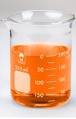
Rifampin
Inhibits DNA-dependent RNA polymerase
  Effective against most Gm positive & many Gm negative (such as Neisseria meningitidis)
Bactericidal both intra & extracellularly
Excretion: 60-65% in feces & > 30% in urine
Stimulates cyt P450: may decrease efficacy of OCPs, coumadin, methadone, steroids, HIV tx, among others
Resistance: 10⁷⁻⁸ bacteria is resistant 2/2 target alteration which reduces binding
http://www.urinecolors.com/orange_urine_color.php

Slide 29
Pyrazinamide (PZA)
Targets mycobacterial fatty acid synthase I (mycolic acid synthesis)
Bacteridical at acidic pH (used during initial phase w/ active cavitary lesions)
Mainly urinary excretion
Side effects: hepatic dysfunction (15%), hyperuricemia (inhibits excretion)
Renal dosing: longer interval preferred over lowering each dose

Slide 30
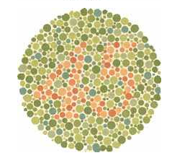
Ethambutol
Inhibits arabinosyl transferases
No effect on other bacteria
Bacteriostatic
Helps prevent resistance to other drugs
75% excreted in urine
Side effects: optic neuritis (incidence proportional to dose & intensity related to duration of tx)
    Baseline visual acuity & red-green color discrimination
    Inquire about blurred vision & scotoma at every visit
Renal dosing: longer interval preferred over lowering each dose
http://www.toledo-bend.com/colorblind/Ishihara.asp

Slide 31
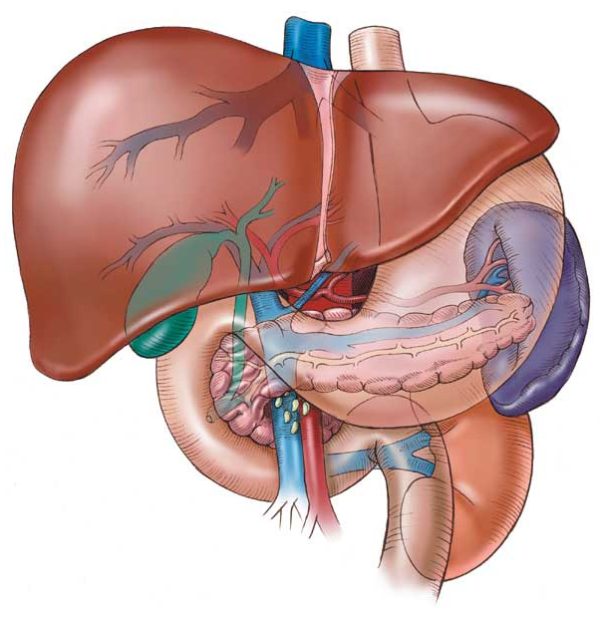
Monitoring
Baseline LFTs, CBC, creatinine, uric acid
HIV, hep B & C for pt’s w/ risk
Discontinue tx if LFTs > 3x’s upper limit of normal in symptomatic pt or > 4x’s in asymptomatic
  Use alternate therapy until LFTs < 2-3 x’s upper limit, then restart medications one at a time each week (RIF +/- EMB → INH → +/- PZA)
http://healthfiles.net/tag/fatty-liver/

Slide 32
Second-line therapy
Used only by experienced practitioners
Fluoroquinolones: No phase 3 trials to assess relapse rates or optimal duration
  Used only in pt’s who cannot tolerate or have resistance to first-line agents
  Consider possibility of resistance in pt’s who have received FQ monotherapy for tx of other infections recently
Aminoglycoside
Streptomycin (injectable)
Para-aminosalicylic acid (PAS)
Cycloserine
Ethionamide

Slide 33
References
Mandell et al. 2009. Mandell, Douglas, and Bennett's Principles and Practice of Infectious Diseases, 7th ed. Elsevier, Philadelphia.
Kumar et al. 2010. Robbins & Cotran Pathologic Basis of Disease, 8th ed. Elsevier, New York.
Brunton et al. 2006. Goodman & Gilman’s Pharmacological Basis of Therapeutics, 11th ed. McGraw Hill, New York.
CDC: http://www.cdc.gov/nchhstp/
WHO: http://www.who.int/topics/tuberculosis/en/
von Reyn, C Fordham. 2009. BCG vaccination. UpToDate v19.3.
Basgoz, Nesli. 2010. Clinical manifestations of pulmonary tuberculosis. UpToDate v19.3.
Pai, Madhukar; Menzies, Dick. 2011. Diagnosis of latent tuberculosis infection in adults. UpToDate v19.3.
Basgoz, Nesli. 2011. Clinical manifestations; diagnosis; and treatment of miliary tuberculosis. UpToDate v19.3.
Pai, Madhukar; Menzies, Dick. 2011. Interferon-gamma release assay for latent tuberculosis. UpToDate v19.3.
Sterling, Timothy R. 2011. Tretment of tuberculosis in HIV-negative patients. UpToDate v19.3.
Horsburgh, Jr, C Robert. 2011. Treatment of latent tuberculosis infection in HIV-negative adults. UpToDate v19.3.
Leonard, John. 2010. Central nervous system tuberculosis. UpToDate v19.3.
McDonald, Malcolm; Sexton, Daniel. 2010. Skeletal tuberculosis. UpToDate v19.3.

